Slide 1
3 Dec 2023
TA
STUDENTS
SMAI Project : Team Hax
Khushi Agrawal
Ashutosh Srivastava
Harshvardhan SV
Self Normalising
Neural Networks

Slide 2
Table of
Contents
Page
I
Introduction : Parameter Tuning
3
II
Datasets
6
III
Observations
9
IV
Research Beyond the paper
10
V
Conclusion & Discussions
12

Slide 3

I
Introduction:
SELU Activation function
FNN are typically shallow and lacks the ability to exploit many levels of abstract representations.
Neuron activations of SNNs (SELUs) automatically converges towards zero mean and unit variance
Advantages:
i) Train Deep Networks with many layers
ii) Employ strong regularization
iii)Make learning highly robust
3

Slide 4
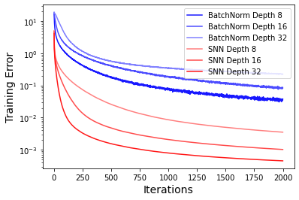
I
Introduction :
SELU Activation function
Training with Normalization techniques are perturbed by SGD , stochastic regularization (like dropout) , estimation of normalization parameters etc.
RNNs and CNNs can stabilize the learning as they use weight sharing but FNNs are more prone to these perturbations and have high variance in target error as seen in the fig
3

Slide 5


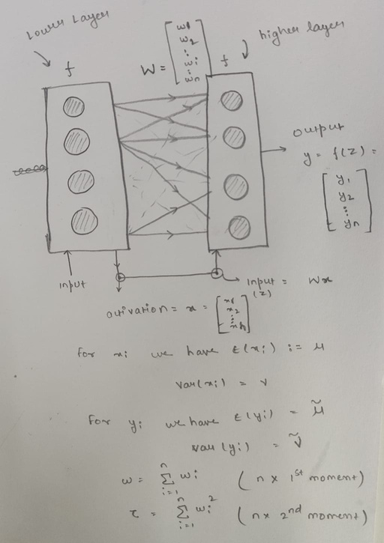
I
Definition :
4

Slide 6

2 design choices are availiable:
i) The activation function
ii) Initialization of the weights
I
Definition :
Constructing Self-Normalizing Neural Networks :
Why ?
i) Negative and positive values for controlling mean
ii) Saturation regions(derivatives approaching zero) to dampen variance if too large
iii) A Slope larger than one to increase the variance if its too small
iv) Continuous Curve to ensure fixed points
4

Slide 7
I
Introduction:
SELU Activation function
Activations of a neural networks are considered to be normalized if both their means and variance are inside fixed intervals and it’s transitive . Thus applying the mapping g , each point would converge to a fixed point.
3

Slide 8
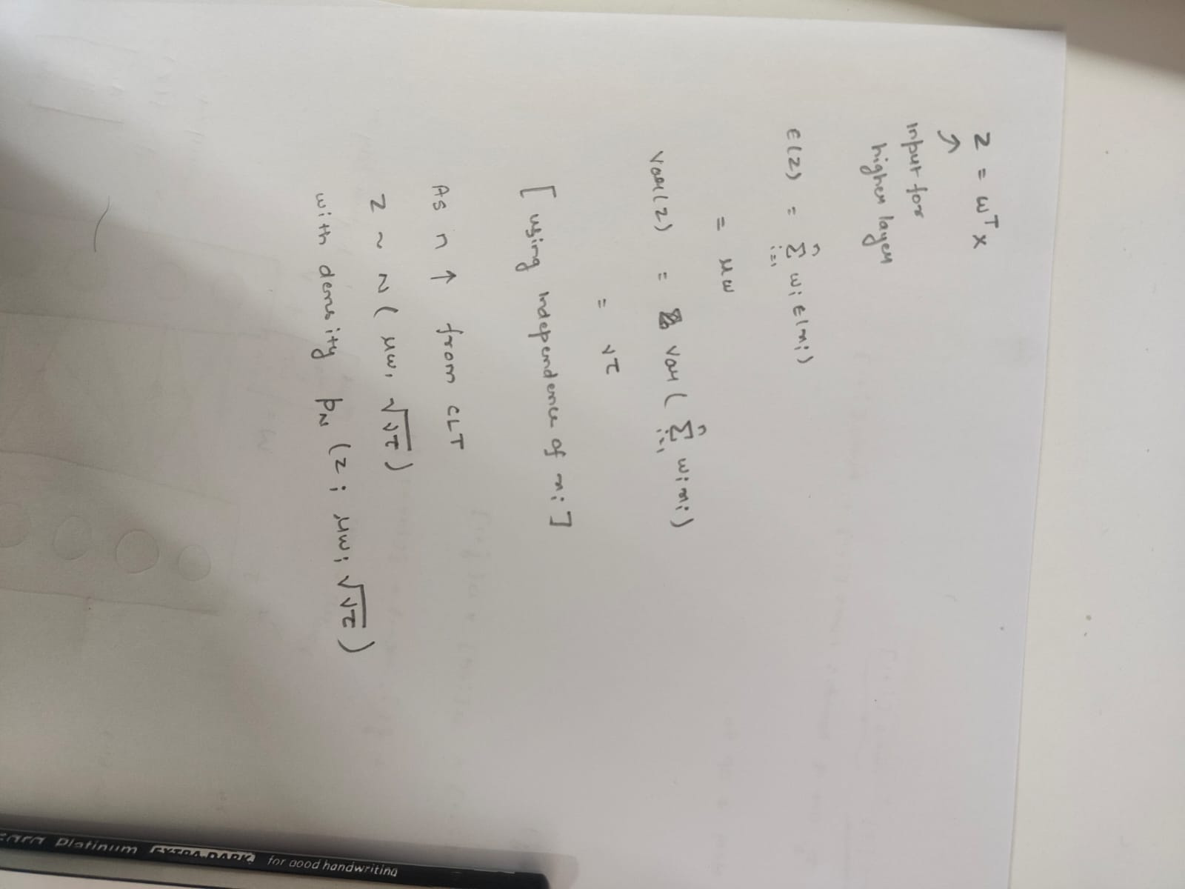
I
Introduction:
Deriving the Mean and Variance Mapping Function g
3

Slide 9
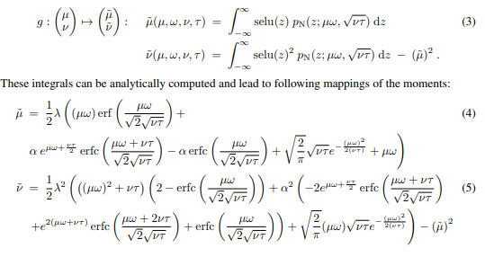
I
Introduction:
Deriving the Mean and Variance Mapping Function g
3

Slide 10

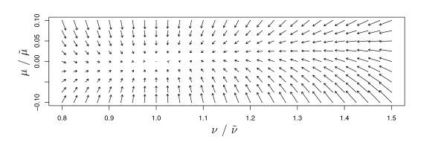
I
Introduction:
Is the point (0,1) stable and attracting?
On putting the value (0,1) in the equations we can see parameters : =`1.6733 and = 1.05007 and calculating the Jacobian we get
And the spectral norm J(0,1) = 0.7877 , thus the it’s a contraction mapping
3

Slide 11
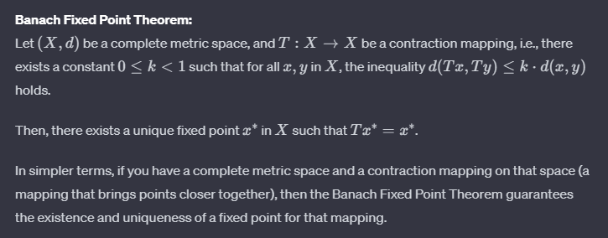
I
Introduction:
But what if the weights are not normalized?
Banach Fixed point Theorem
3

Slide 12
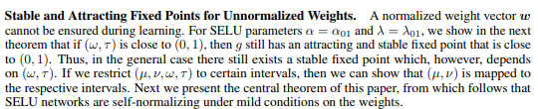
I
Introduction:
But what if the weights are not normalized?
Mild Condition.....
3

Slide 13
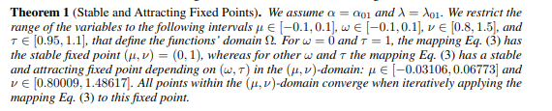
I
Introduction:
But what if the weights are not normalized?
Theorems
3

Slide 14

I
Introduction:
But what if the weights are not normalized?
Theorems
Neuron activations are bounded from below , thus SNNs don’t suffer from vanishing gradients
Neuron activations are bounded from above , thus SNNs don’t suffer from exploding gradients
3

Slide 15
I
Introduction:
But what about Initialisation?
Since SNNs have a fixed point at zero mean and unit variance for normalized weights and
(see above), we initialize SNNs such that these constraints are fulfilled in expectation.
We draw the weights from a Gaussian distribution with E(wi) = 0 and variance Var(wi) = 1/n
Droupout.....
?
3

Slide 16

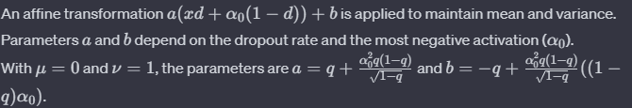
I
Standard Dropout Background:
i) Randomly sets activations to Zero with probability q to prevent overfitting
ii) To maintain the mean , scaling factor of 1/q is applied
Motivation of Alpha Dropout:
i) For SELU , the default and low variance value is
ii) Thus it randomly sets the inputs to instead of 0
Mean and Variance :
New Variance after dropout
Affine transformation to preserve mean and variance
Introduction:
Dropout....
3

Slide 17



II
Datasets
CIFAR 10
Tox 21
The Tox21 challenge dataset comprises about 12,000 chemical compounds whose twelve toxic effects have to be predicted based on their chemical structure.
The Tox21 challenge dataset comprises about 12,000 chemical compounds whose twelve toxic effects have to be predicted based on their chemical structure.
HTRU 2
UCI Machine Learning
The High Time Resolution Universe Survey (HTRU2) dataset has been released with 1,639 real pulsars and 16,259 spurious signals.
It comprises 121 classification datasets from the UCI Machine Learning repository from diverse application areas, such as physics, geology, or biology. The size of the datasets ranges between 10 and 130, 000 data points and the number of features from 4 to 250.
5

Slide 18
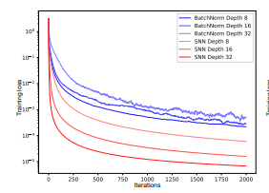
II
CIFAR 10
Architecture : CNN
Batch Norm
68 %
Weight Norm
72 %
Layer Norm
63 %
SELU
82 %
6

Slide 19
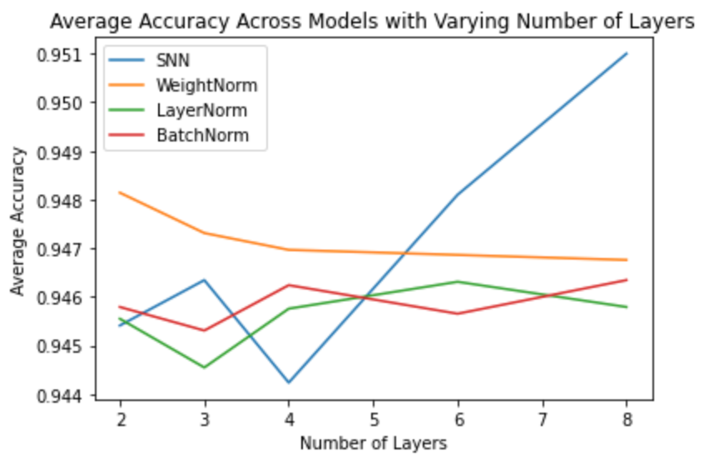
II
TOX 21
Architecture : CNN
Batch Norm
70 %
Weight Norm
70 %
Layer Norm
70 %
SELU
70 %
7

Slide 20
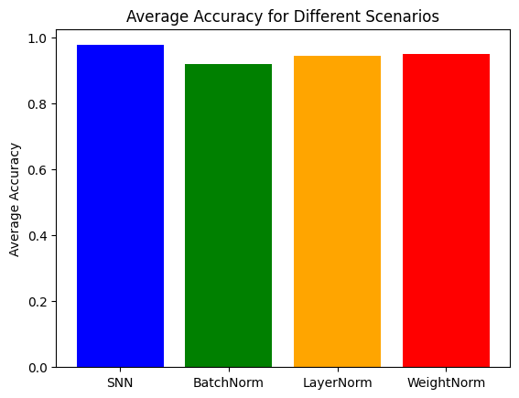
II
HTRU 2
Architecture : CNN
8

Slide 21
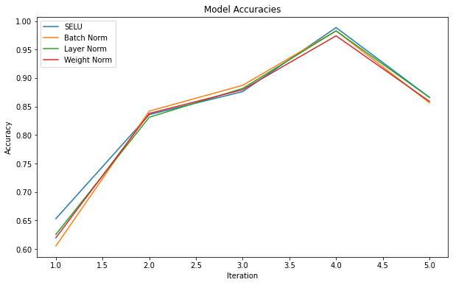
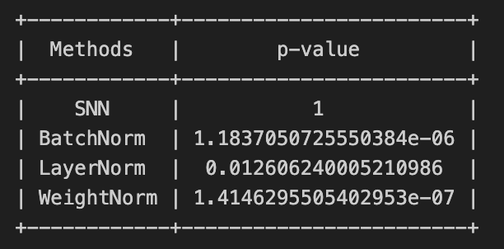
II
UCI Machine Learning Dataset
Architecture : CNN
9

Slide 22

III
Research Beyond the paper
Deep CNNs only converge with SELU
CNN architectures with more than 50 layers only converge with SELU
Tested deep CNNs on CIFAR 100 to demonstrate that CNNs will only converge with SELU
Dummy CNN model to test convergence against other normalisation techniques
10

Slide 23
III
Research Beyond the paper
Generative models
Generative models take an immense amount of time for training. Applying SELU reduces training time significantly.
DC GANs with selu activation function
Inception score metric to evaluate generated images
11

Slide 24
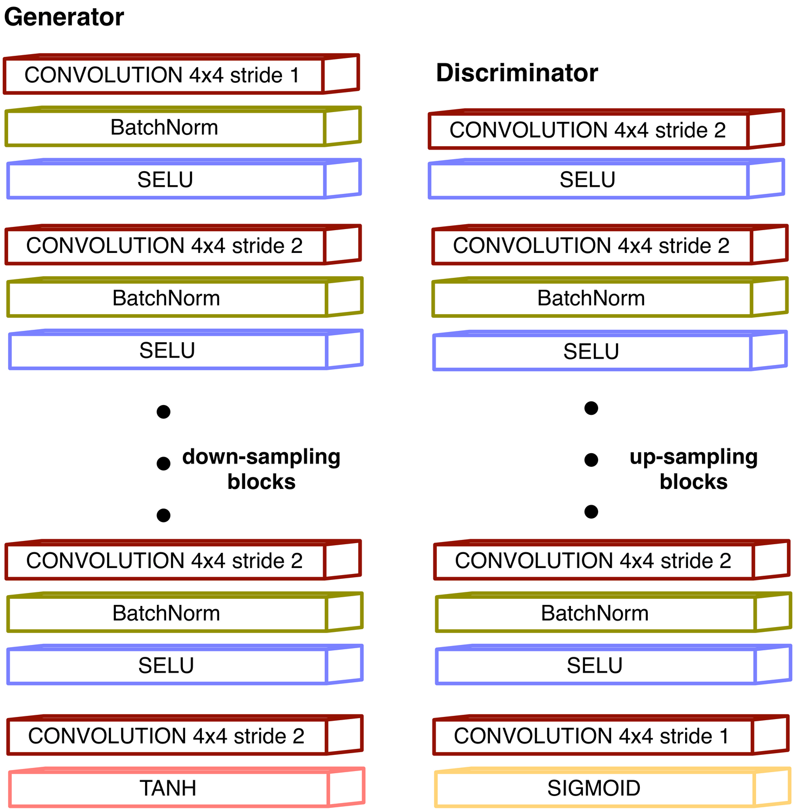
III
DC GAN
We trained a DC GAN with SELU activation instead of Leaky RELU and compared the results using inception score.
Inception Score for DC GAN : (2.06,0)
Inception Score for DC GAN with SELU : (2.52,0)
INCEPTION SCORE
The Inception Score is a metric used to evaluate the quality and diversity of generated images in the context of generative models, particularly in the field of deep learning and generative adversarial networks (GANs).
12

Slide 25
III
INCEPTION SCORE
Inception Model:
The Inception Score is often computed using a pre-trained Inception model, which is a deep convolutional neural network originally designed for image classification tasks.
Image Generation:
The generative model, such as a GAN, generates a set of images.
Inception Model Prediction:
Each generated image is passed through the pre-trained Inception model to obtain class probabilities for different objects.
Entropy Calculation:
The Inception Score involves calculating the entropy of the class probabilities distribution for each generated image. Higher entropy indicates more diversity in predicted classes.
Average Entropy:
The average entropy of class probabilities across all generated images is computed. A higher average entropy suggests diverse and realistic images.
Inception Score Calculation:
The final Inception Score is computed by exponentiating the average entropy and multiplying it by the overall accuracy of the Inception model on the generated images.
12

Slide 26
We knew it was boring .....And truly appreciate your patience
Thank You....
12

